Slide 1
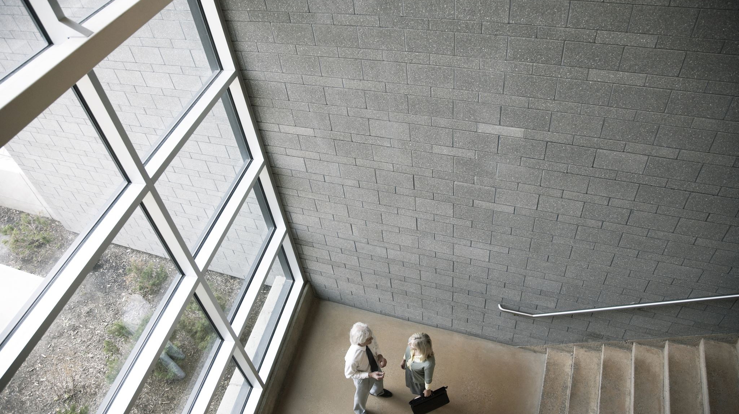
Finding the best place in Toronto
Arturo Asto

Slide 2
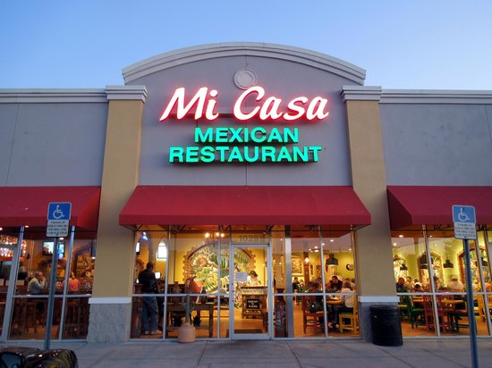
Finding the best place in Toronto for business
Mi Casa ( My Home)
Start a new business can be challenging, in this case we want to focus on the posibility to start a Mexican restaurant in Toronto.

Slide 3
Data Acquisition and cleaning
Steps that we follow:
The postal codes of Toronto available in Wikipedia.
The latitude and longitude of each postal code in order to be displayed on the map.
Remove and rename invalid data.
Merging the data from Wikipedia and FourSquare in order to create a dataframe.

Slide 4

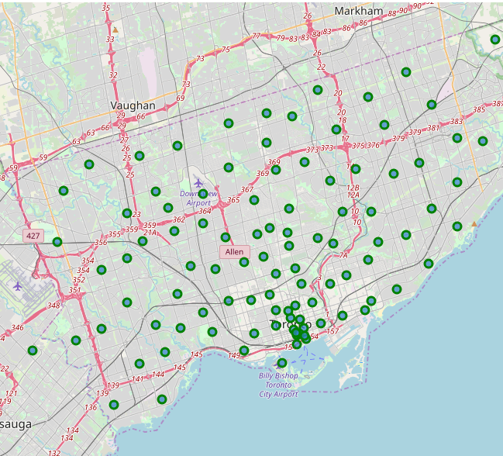
Toronto Neighbourhoods
All the Toronto neighbourhoods are displayed in the map.

Slide 5
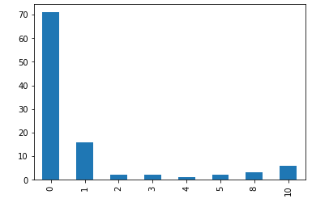
Mexicans restaurants
Here is a bar graph that shows how the quantity of Mexican restaurants per neighbourhood.
We can see that most of the locations doesn’t have a Mexican restaurant nearby.

Slide 6
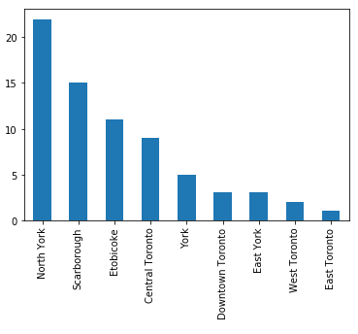
Neighbourhoods without a Mexican restaurant
In this case North York is the location with less Mexican restaurants in their neighbourhoods.

Slide 7
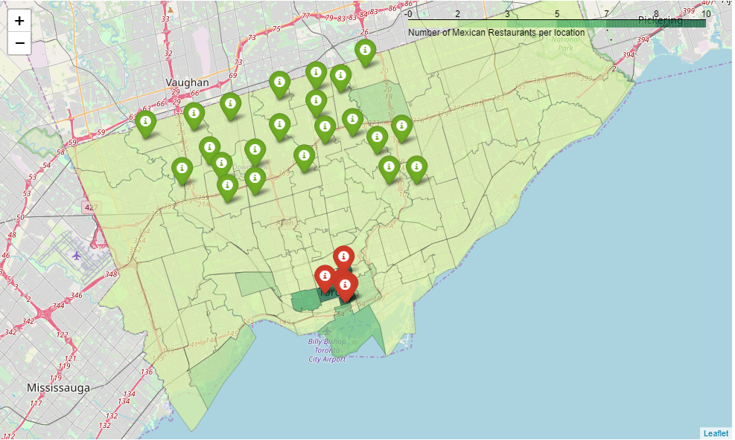
Heat map of toronto
The green markers represent the areas in North York available to start a business.
The red markers represent the areas with the most Mexican restaurants nearby.

Slide 8
Conclusion
Finally this project can serve as a guide to people interested in starting a business in Toronto.
North York is the result of our study to be the best place where we can start a Mexican restaurant.

